Slide 1
Using Minimal Spanning Trees as a Heuristic for solving TSP
Remember these, we have a few algorithms that can find a minimal spanning tree of a network in polynomial time so why don’t we try this and then walk the tree?
If we get to a point where we would need to go back to an already visited node, then we’ll just walk to one of the other nodes that haven’t been visited but that are connected in the original graph (probably the next shortest path) and keep going. At the end, we just need to walk from the last city to the first again to complete the circuit.
O(n²)
O(n²)
so we’ve just found some solutions in O(n²)
are they likely to be optimal though?
Notes:
MST pre-order traveral + triangle inequality only works for euclidean TSP tho
Full-walk of MST (back tracking over edges etc.) still < 2 * shortest possible path, euclidean or not

Slide 2
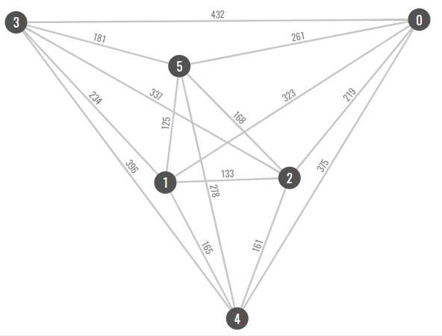

Slide 3
Minimum spanning tree cost = 819

Slide 4
Let’s walk the tree…
Minimum spanning tree cost = 819

Slide 5
Let’s walk the tree…
Minimum spanning tree cost = 819

Slide 6
Let’s walk the tree…
Minimum spanning tree cost = 819

Slide 7
Let’s walk the tree…
Minimum spanning tree cost = 819

Slide 8
Let’s walk the tree…
Minimum spanning tree cost = 819

Slide 9
Let’s walk the tree…
Minimum spanning tree cost = 819

Slide 10
And return to the start…
Minimum spanning tree cost = 819

Slide 11
Minimum spanning tree cost = 819

Slide 12
Minimum spanning tree cost = 819
We can do slightly better here….

Slide 13
Minimum spanning tree cost = 819
Whenever we ‘backtrack’ and go to the next node...

Slide 14
Minimum spanning tree cost = 819
Because of the triangle inequality, it will always be shorter to go directly to the next node.

Slide 15
Minimum spanning tree cost = 819
Because of the triangle inequality, it will always be shorter to go directly to the next node.

Slide 16
Minimum spanning tree cost = 819
Final Path cost = 1283

Slide 17
Minimum spanning tree cost = 819
Final Path cost = 1283
It can shown that the cost of this path can never be more than twice the cost of optimal path…

Slide 18
Minimum spanning tree cost = 819
Final Path cost = 1283
MST cost < Optimal TSP path
A full walk of the MST is 2 x MST cost
2 x MST cost < 2 x Optimal TSP path

Slide 19
Using Minimal Spanning Trees as a Heuristic for solving TSP
If we get to a point where we would need to go back to an already visited node, then we’ll just walk to one of the other nodes that haven’t been visited but that are connected in the original graph (probably the next shortest path) and keep going. At the end, we just need to walk from the last city to the first again to complete the circuit.
O(n²)
So we’ve just found some solutions in O(n²)
Are they likely to be optimal though?
….NO, but they are tractable!
Notes:
MST pre-order traveral + triangle inequality only works for euclidean TSP tho
Full-walk of MST (back tracking over edges etc.) still < 2 * shortest possible path, euclidean or not

